Slide 1

Rationale
Introduction to Windows Store App Development Using HTML5 and JavaScript
Computer science is a field of study that deals with solving a variety of problems by using computers.
  To solve a given problem by using computers, you need to design an algorithm for it.
Multiple algorithms can be designed to solve a particular problem.
An algorithm that provides the maximum efficiency should be used for solving the problem.
  The efficiency of an algorithm can be improved by using an appropriate data structure.
Data structures help in creating programs that are simple, reusable, and easy to maintain.
This module will enable a learner to select and implement an appropriate data structure and algorithm to solve a given programming problem.

Slide 2
Objectives
  In this session, you will learn to:
  Work with UI events
Notes:
2

Slide 3
Working with UI Events
  Depending on the actions that the user performs, different types of events occur.
  To perform specific actions on the occurrence of any of these events, you need to:
Define an event handler.
Associate the event handler with the source of the event.
Notes:
3

Slide 4
Identifying UI Events
  An event can be defined as a message sent by an object or by a control to notify the occurrence of an action.
  In order to handle events, you need to first identify the events notified by the various UI elements.
  The common events associated with the UI elements are:
onclick | onkeydown
onchange | onkeypress
ondblclick | onkeyup
ondragstart | onmousedown
ondragenter | onmousemove
ondragleave | onmouseout
ondrop | onmouseup
Notes:
4

Slide 5
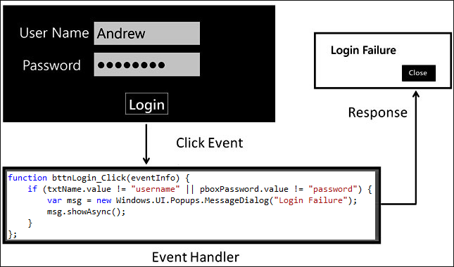
Defining Event Handlers for UI Elements
  To handle an event associated with a particular UI element, you need to define a UI event handler.
  The following figure shows the event handling process for performing the login function in an app.
Notes:
5
Explain the scenario.

Slide 6
Associating Event Handlers with UI Elements
  After defining the event handler for a UI element, you need to associate the event handler with the appropriate event of the desired UI element.
  You can associate a control with the corresponding event handlers using the following models:
Classic (HTML) Event Model
Interoperable (W3C) Event Model
Microsoft Event Model
Notes:
6

Slide 7
Associating Event Handlers with UI Elements (Contd.)
  Classic (HTML) Event Model:
  To associate an event handler with a UI element using this model, the following syntax is used:
    <elementName>.<eventName>
    = <eventHandlerFunctionName>;
Notes:
7
Explain the syntax.

Slide 8
Associating Event Handlers with UI Elements (Contd.)
  Interoperable (W3C) Event Model:
  In this model, the addEventListener() method is used to associate an event handler with a UI element.
  The following syntax is used to associate an event handler with a UI element using this method:
    <elementName>.addEventListener("<eventName>", <eventHandlerName>, [capture]);
Notes:
8
Explain the syntax.

Slide 9
Associating Event Handlers with UI Elements (Contd.)
  Microsoft Event Model:
  In this model, the attachEvent() method is used to associate an event handler with a UI element.
  The following syntax is used to associate an event handler with a UI element using this method:
    <elementName>.attachEvent("<eventName>", <eventHandlerName>);
Let us look at an example, which handles the UI events
Notes:
9
Explain the syntax.

Slide 10
Handling Changes in View State
  When an app is launched, it is rendered in full screen view.
  You can record a change in the view state and respond to it by using the window.onresize event.
Let us look at an example, which handles the onresize event
Notes:
10
Explain using example given in the SG.

Slide 11


Just a Minute
  Identify the property that is used to determine the available width of a window object.
    1. width
    2. windowWidth
    3. innerWidth
    4. availableWidth

Slide 12
Just a Minute (Contd.)
  Solution:
    3. innerWidth

Slide 13
Summary
  In this session, you learned that:
  To handle an event associated with an app, you need to define an event handler.
  An event handler is the code that needs to be executed whenever the corresponding event occurs.
  You can associate a control with the corresponding event handlers using the following models:
    Classic (HTML) Event Model
    Interoperable (W3C) Event Model
    Microsoft Event Model
Notes:
13

Slide 14
What’s Next?
  You need to perform the following exercises of IWSADHJ Chapter 2 in the MR session:
  Exercise 2
  Exercise 3
  Exercise 4
  Exercise 5

Slide 15

Q&A

